Slide 1

SQL PROJECT
Yakubu Ruth
Order Management Dataset
Presented by: Ruth Yakubu

Slide 2
SQL PROJECT- Order Management DB
Yakubu Ruth
I used three simple tables — customers, orders, order_items to answer business questions using advanced SQL (subqueries, window functions, CTEs).
This project shows how SQL unlocks business value, step by step.

Slide 3
Objectives
Yakubu Ruth
Understand dataset structure and relationships.
Clean and prepare data for analysis.
Use subqueries, window functions, and CTEs to solve real business questions.
Produce clear Result and actionable insights recruiters can read in 30 seconds

Slide 4
Business problem / questions
Yakubu Ruth
1. Get all customers with their orders.
2. List all customers and their orders (even those with no orders).
3. Find customers who spent above the average order amount.
4. Find each customer’s total spending
5. Rank customers by their total spending.
6. Show orders with a running total of spending by date.
7. List each order with the products and total price per item.
8. Find the highest order amount and the customer who made it.
9. Find customers who placed more than one order.
10. Rank products by total sales value.
11. Find the names of customers who bought a Laptop.
12. Show each order and the customer’s average order amount.
13. Find pairs of customers from the same country.
14. Divide customers into 3 spending tiers.

Slide 5
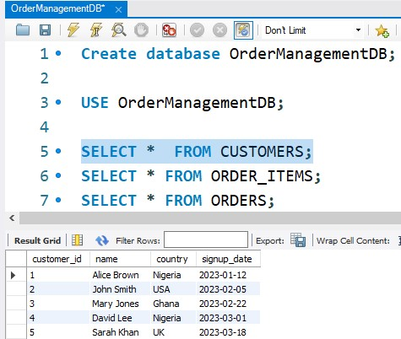
Dataset Overview- Customers Dataset
Yakubu Ruth
customers: customer_id, name,
Signup_date, country
orders: order_id, customer_id, order_date, total_amount
order_items: item_id, order_id, product_name, quantity, price

Slide 6
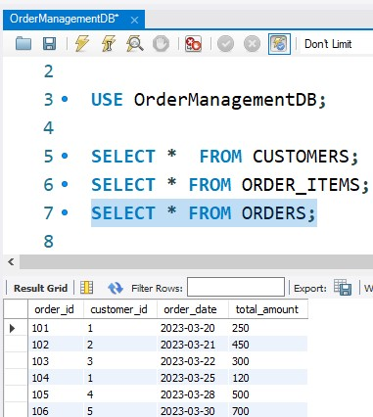
Dataset Overview- Orders Dataset
Yakubu Ruth
customers: customer_id, name,
Signup_date, country
orders: order_id, customer_id, order_date, total_amount
order_items: item_id, order_id, product_name, quantity, price

Slide 7
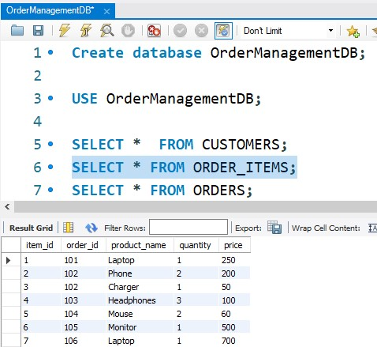
Dataset Overview- Order_items Dataset
Yakubu Ruth
customers: customer_id, name,
Signup_date, country
orders: order_id, customer_id, order_date, total_amount
order_items: item_id, order_id, product_name, quantity, price

Slide 8
SQL techniques
Yakubu Ruth
Subqueries: find per-customer or per-order comparisons.
Window functions: ranks, running totals, moving averages.
CTEs (WITH): break a complex task into readable step.
Joins & Aggregations: combine tables and summarize.

Slide 9
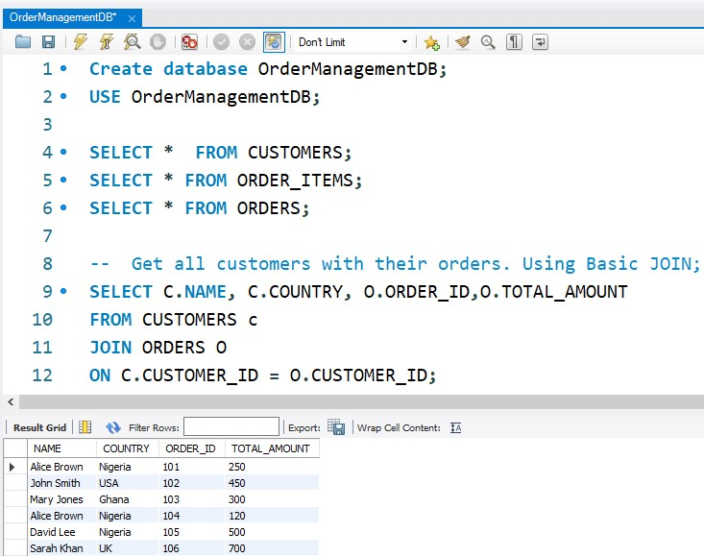
JOIN – Finding customers with their orders
Yakubu Ruth
I used an INNER JOIN to connect Customers and Orders.
The join condition c.customer_id = o.customer_id matches customers with their orders.
This only returns customers who have placed at least one order.
If a customer has multiple orders, they will appear multiple times.

Slide 10
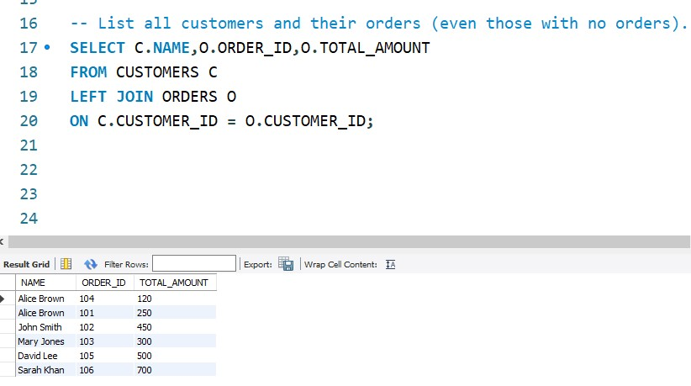
LEFT JOIN- Customers & their orders(even those with no orders)
Yakubu Ruth
A LEFT JOIN returns all rows from the Customers table, even if they don’t match in Orders.
Customers with no orders will still appear, but their order columns will show NULL.
This is useful for finding inactive customers.

Slide 11
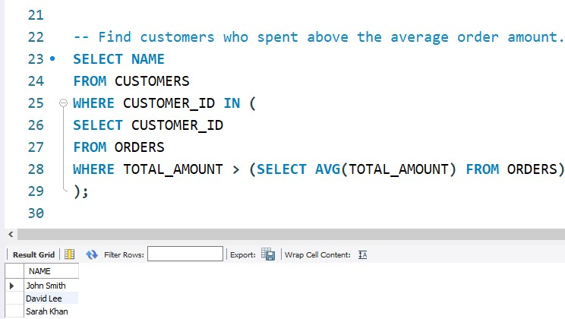
SUBQUERY-Customers who spent above the average order amount
Yakubu Ruth
First, (SELECT AVG(total_amount) FROM Orders) calculates the average order value.
The inner query finds customers who have at least one order above this average.
The outer query matches those customers in the Customers table.
This highlights high-value customers.

Slide 12
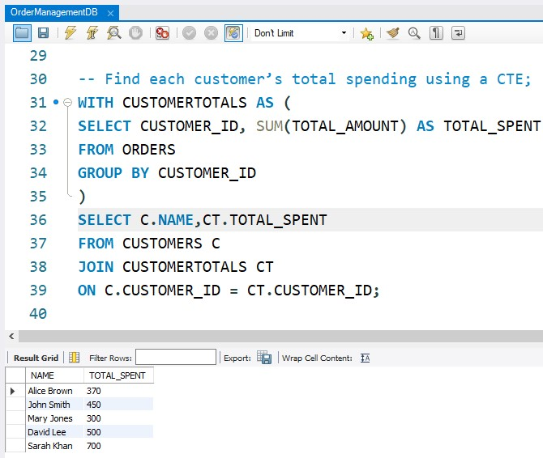
CTE-Customer’s total spending shows total spending per customers
Yakubu Ruth
A CTE (Common Table Expression) makes the query easier to read by breaking it into steps.
Inside the CTE, I calculated total spending per customer.
Then I joined back to Customers to show names.
This is cleaner than nesting subqueries and is reusable if needed.

Slide 13
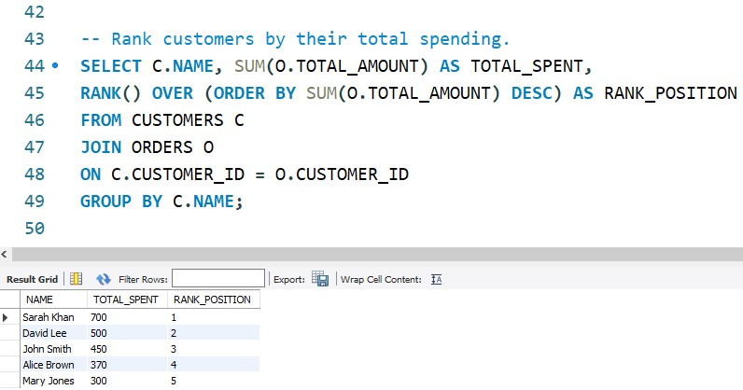
Window Function – Rank customers by spending(Ranks customers by total purchase value.)
Yakubu Ruth
SUM(o.total_amount) calculates total spending per customer.
RANK() OVER (ORDER BY SUM(o.total_amount) DESC) assigns ranks, with 1 being the top spender.
If two customers spent the same amount, they get the same rank.

Slide 14
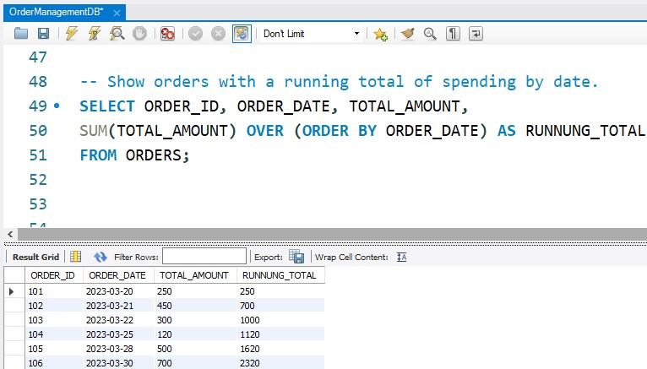
Window Function – Running total of spending (Displays how spending accumulates over time.)
Yakubu Ruth
A running total accumulates values as we go down rows.
SUM() OVER (ORDER BY order_date) keeps adding amounts in chronological order.
Useful for sales trends or cumulative revenue analysis.

Slide 15
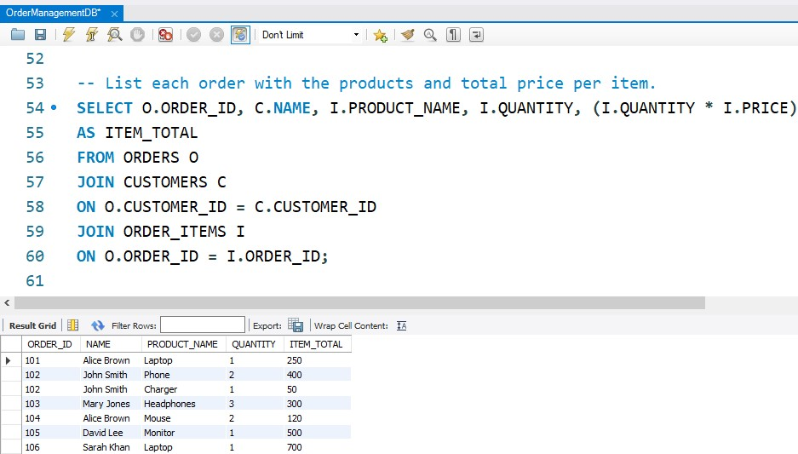
Advanced JOIN – Order with item details Breaks down each order into item-level details.
Yakubu Ruth
Here I joined all 3 tables: Orders, Customers, and Order_Items.
Each row shows the product details for a customer’s order.
i.quantity * i.price calculates the value per product in the order.

Slide 16
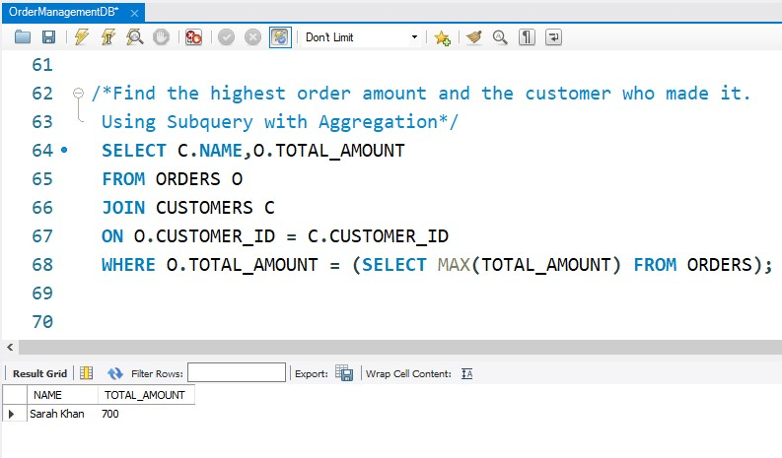
Subquery with Aggregation – Highest order amount
Yakubu Ruth
(SELECT MAX(total_amount) FROM Orders) finds the largest order value.
I return the customer(s) who placed that order.
If multiple customers tied for the maximum, all appear.

Slide 17
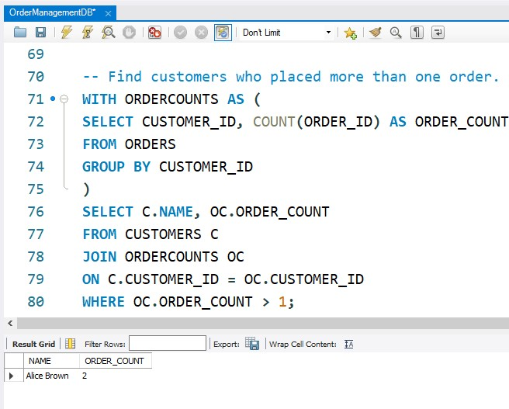
CTE with Filtering – Customers with more than one order
Yakubu Ruth
First we count orders per customer inside the CTE.
Then I filtered only those with order_count > 1.
A clean way to identify repeat buyers.

Slide 18
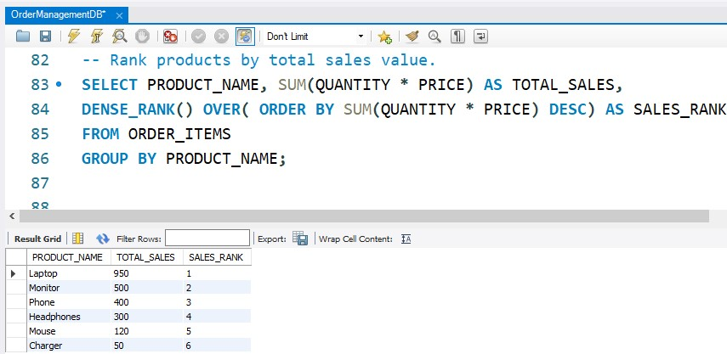
Window Function – Rank products by sales value
Yakubu Ruth
I calculate total sales for each product (quantity * price).
DENSE_RANK() assigns ranks without skipping numbers.
Great for top product analysis.

Slide 19
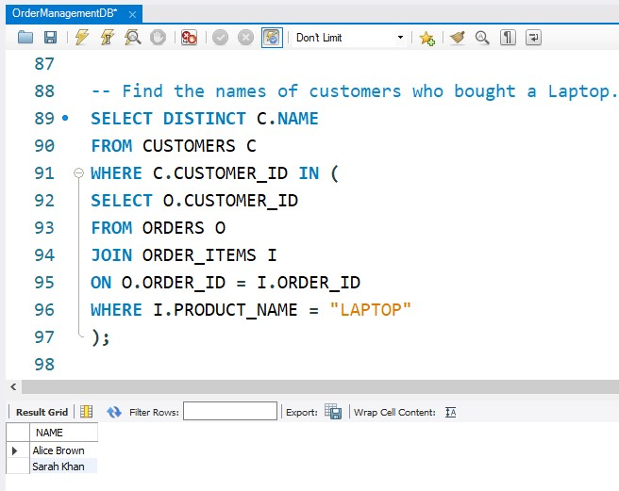
Nested Subquery – Customers who bought a Laptop
Yakubu Ruth
Inner query finds customer_ids for orders containing a Laptop.
Outer query returns customer names.
DISTINCT ensures customers appear only once.

Slide 20
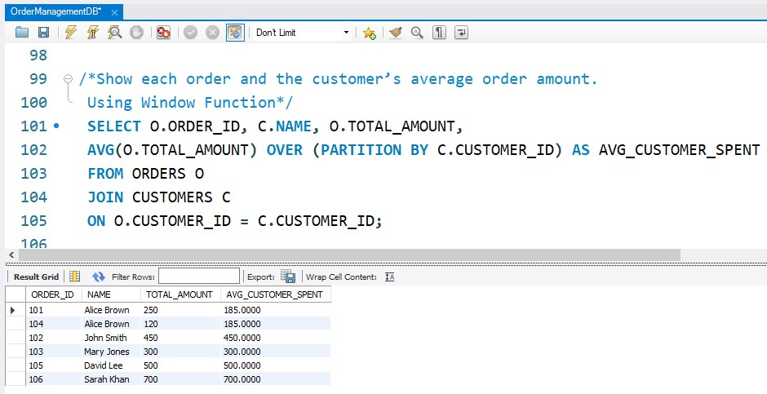
Window Function with Partition – Orders with customer’s avg spend
Yakubu Ruth
PARTITION BY calculates an average per customer, not overall.
Each order is compared to that customer’s personal average.
Useful for spotting above/below average purchases per customer.

Slide 21
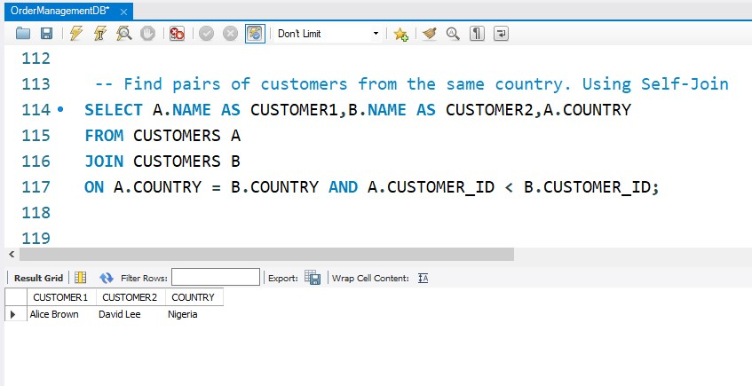
Self-Join – Customer pairs in the same country
Yakubu Ruth
A self-join is when a table joins with itself.
I paired up customers from the same country.
a.customer_id < b.customer_id avoids duplicates (e.g., Alice–John and John–Alice).

Slide 22
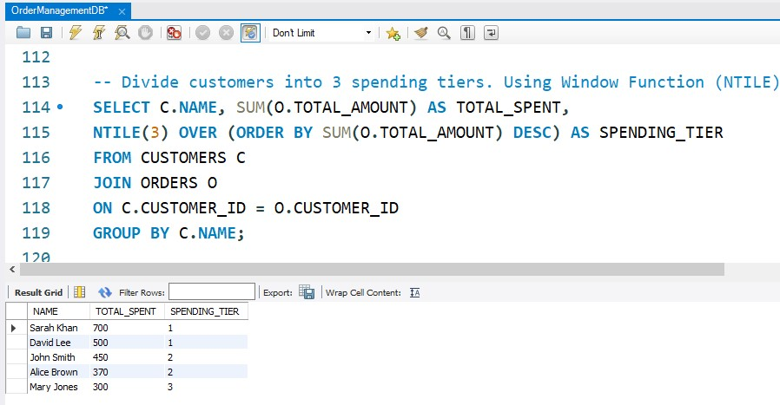
Window Function – Divide customers into spending tiers
Yakubu Ruth
NTILE(3) divides the ranked results into 3 groups (tiers).
Customers in tier 1 are top spenders, tier 3 are low spenders.
A powerful way to create customer segments for marketing.

Slide 23
Next Step
Yakubu Ruth
Practice writing your own queries on similar datasets
Explore more advanced SQL: CROSS APPLY, recursive CTEs, performance tuning
Extend analysis to dashboards (Power BI, Tableau)
Share your results on GitHub or LinkedIn to showcase your skills

Slide 24
Final Thoughts
Yakubu Ruth
SQL is not just about syntax — it’s about solving real business problems
Start small, build step by step, and always explain your results in plain language
Keep experimenting, keep sharing, keep learning

Slide 25
Thank You
Yakubu Ruth
Full project + code available on GitHub
Let’s connect: LinkedIn @Ruth Yakubu
Questions? Feedback? Drop me a message!

